Slide 1
MERGE SORT
Notes:
Todays topic is merge sort, which is an sorting algorithm.
In the previous lectures we have studies Linear Sorting Algorithms like Bubble Sort, Selection Sort and Insertion Sort.

Slide 2
MergeSort
MergeSort is a divide and conquer method of sorting
Notes:
Merge Sort is not linear sorting algorithm.

Slide 3
Divide And Conquer
Merge sort divides up an unsorted array until the base case is met and then sorts the divided parts back together in pairs.
Merging two lists of one element each is the same as sorting them.
Specifically this can be done by recursively dividing the unsorted list in half, merge sorting the right side then the left side and then merging the right and left back together.
Notes:
In divide and conquer we divide the problem into sub problems and we continue doing this till me meet the base case.
When the size of problem is so small that we can answer directly is base case.
In conquer part we merge all the sub solution to construct solution of the big problem.

Slide 4
Merge Sort Example
99 | 6 | 86 | 15 | 58 | 35 | 86 | 4 | 0

Slide 5
Merge Sort Example
99 | 6 | 86 | 15 | 58 | 35 | 86 | 4 | 0
99 | 6 | 86 | 15
58 | 35 | 86 | 4 | 0

Slide 6
Merge Sort Example
99 | 6 | 86 | 15 | 58 | 35 | 86 | 4 | 0
99 | 6 | 86 | 15
58 | 35 | 86 | 4 | 0
99 | 6
86 | 15
58 | 35
86 | 4 | 0

Slide 7
Merge Sort Example
99 | 6 | 86 | 15 | 58 | 35 | 86 | 4 | 0
99 | 6 | 86 | 15
58 | 35 | 86 | 4 | 0
99 | 6
86 | 15
58 | 35
86 | 4 | 0
99
6
86
15
58
35
86
4 | 0

Slide 8
Merge Sort Example
99 | 6 | 86 | 15 | 58 | 35 | 86 | 4 | 0
99 | 6 | 86 | 15
58 | 35 | 86 | 4 | 0
99 | 6
86 | 15
58 | 35
86 | 4 | 0
99
6
86
15
58
35
86
4 | 0
4
0

Slide 9
Merge Sort Example
99
6
86
15
58
35
86
0 | 4
Merge
4
0

Slide 10
Merge Sort Example
6 | 99
15 | 86
35 | 58
0 | 4 | 86
99
6
86
15
58
35
86
0 | 4
Merge

Slide 11
Merge Sort Example
6 | 15 | 86 | 99
0 | 4 | 35 | 58 | 86
6 | 99
15 | 86
58 | 35
0 | 4 | 86
Merge

Slide 12
Merge Sort Example
0 | 4 | 6 | 15 | 35 | 58 | 86 | 86 | 99
6 | 15 | 86 | 99
0 | 4 | 35 | 58 | 86
Merge

Slide 13
Merge Sort Example
0 | 4 | 6 | 15 | 35 | 58 | 86 | 86 | 99

Slide 14
Merging (cont.)
X:
3 | 10 | 23 | 54
Y:
1 | 5 | 25 | 75
Result:

Slide 15
Merging (cont.)
X:
3 | 10 | 23 | 54
Y:
 | 5 | 25 | 75
Result:
1

Slide 16
Merging (cont.)
X:
 | 10 | 23 | 54
Y:
 | 5 | 25 | 75
Result:
1 | 3

Slide 17
Merging (cont.)
X:
 | 10 | 23 | 54
Y:
 |  | 25 | 75
Result:
1 | 3 | 5

Slide 18
Merging (cont.)
X:
 |  | 23 | 54
Y:
 |  | 25 | 75
Result:
1 | 3 | 5 | 10

Slide 19
Merging (cont.)
X:
 |  |  | 54
Y:
 |  | 25 | 75
Result:
1 | 3 | 5 | 10 | 23

Slide 20
Merging (cont.)
X:
 |  |  | 54
Y:
 |  |  | 75
Result:
1 | 3 | 5 | 10 | 23 | 25

Slide 21
Merging (cont.)
X:
Y:
 |  |  | 75
Result:
1 | 3 | 5 | 10 | 23 | 25 | 54

Slide 22
Merging (cont.)
X:
Y:
Result:
1 | 3 | 5 | 10 | 23 | 25 | 54 | 75

Slide 23
Implementing Merge Sort
public static void MergeSort(int []array)
{
if(array.length < 2 )
{
return;
}
int Mid = array.length / 2;
int []LeftArray = new int [Mid];
int []RightArray = new int [array.length - Mid];
for (int i = 0; i < Mid; i++) {
LeftArray[i] = array[i];
}
for (int i = Mid; i < array.length ; i++) {
RightArray[i - Mid] = array[i];
}
MergeSort(LeftArray);
MergeSort(RightArray);
Merge(LeftArray, RightArray, array);
}
Notes:
This function is recursive function. First few statements takes constant time and the complexity of loops is N.
There are two recursive calls and in both calls the size of problem is exactly half so, it will become 2T(n/2) + n.
2T means two times function call and n/2 because the size of array is half in both calls and n because of merge function complexity was N and upper mentioned loops complexity is also N.

Slide 24
Implementing Merge
public static void Merge(int []Left, int []Right,int []Array){
int n = Array.length;
int nL = Left.length;
int nR = Right.length;
int i=0,j=0,k=0;
while(i < nL && j < nR)
{
if(Left[i] < Right[j])
{
Array[k] = Left[i];
i++;
k++;
}
else
{
Array[k] = Right[j];
j++;
k++;
}
}
while(i < nL)
{
Array[k] = Left[i];
i++;
k++;
}
while(j < nR)
{
Array[k] = Right[j];
j++;
k++;
}
}
Notes:
In the first loop we compare left and right array. Suppose right array is completely copied in the original array then loop will terminate and second loop will execute that will copy the contents of left array in right. Suppose 1 loop breaks due to left array then second loop will not execute and third loop will execute that will copy the contents of right array into original array.
Analysis:
Now we will find the time complexity quick sort. Merge Function is not a recursive function so, we will calculate its complexity.
There are 3 loops. Time complexity of this function is : O(n). As we focus on highest order term that is n.

Slide 25
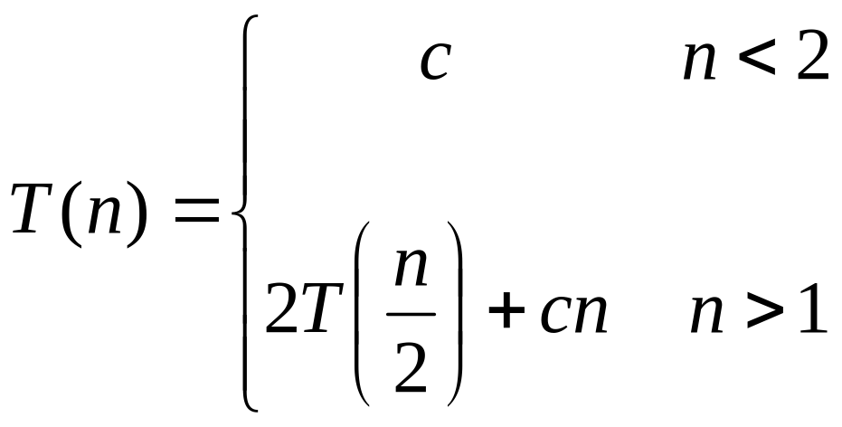
Merge Sort Analysis
The Merge Sort runs O (N log N) for all cases, because of its Divide and Conquer approach.
T(N) = 2T(N/2) + N = O(N logN)
Space complexity = O(N)
Notes:
Solve this recurrence relation using iteration method as discussed earlier in the previous classes.
Space complexity is O(N) because each time two new arrays were created as Left and Right array.

Slide 26
QUESTIONS

